Slide 1
Starter
Round…
5435.52 to the …
Nearest Ten | Nearest Integer | Nearest Hundred | Nearest Thousand | 1 decimal place | 1 significant figure
5440 | 5436 | 5400 | 5000 | 5435.5 | 5000
73.99 to the …
Nearest Five | 1 Decimal place | 2 decimal places | 2 significant figures | 3 significant figures
75 | 5436 | 5400 | 5000 | 5435.5

Slide 2

12 May 2021
Upper and lower bounds
bodina [Latin] : limit, boundary, boundary stone
Typical questions:
Find the upper and lower bound of “40 rounded to the nearest 10”
Find the upper and lower bound of “40 rounded to 2 significant figures”

Slide 3

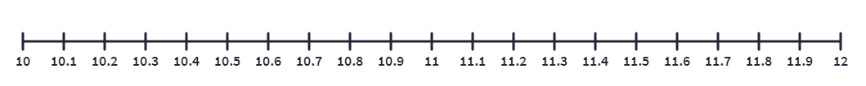
Upper and lower bounds
Example | Your Turn
A circle has a radius of 11 cm (correct to the nearest cm). What is the upper and lower bound of the radius? | A small bridge has a length of 23 m (correct to the nearest m). What is the upper and lower bound of the length of the bridge?
Show number line
Hide number line
Show number line
Hide number line
Notes:
This is an example problem pair. The best place to start out with these is Craig Barton’s book ‘How I Wish I Taught Maths’. The basic idea is this : they copy down the slide. You do the example, writing on the powerpoint and they copy it down. You then reveal the ‘your turn’ question. They then have a go and you can check they can apply the procedure correctly. It’s a really nice way of teaching, I’ve found. I have left the explanation completely up to you, as I wanted to get away from clicking through explanations, which I’m not a fan of.

Slide 4
Upper and lower bounds
Here are some multiple choice questions.
Which answer is correct and why?
A number, rounded to the nearest 10, is 40. What is the lower bound?
A number, rounded to the nearest 10, is 40. What is the upper bound?
A number, rounded to the nearest integer, is 4. What is the upper bound?
35
45
34.9
45.9
45
49.5
3.5
4.5
45
A number, rounded to the nearest 100, is 400. What is the lower bound?
A number, rounded to the nearest 100, is 400. What is the upper bound?
A number, rounded to 1 decimal place, is 4.5. What is the upper bound?
305
350
349
450
400.5
405
4.549
4.5
4.55
A number, rounded to 1 significant figure, is 50. What is the upper bound?
A number, rounded to nearest 5, is 25. What is the lower bound?
A number, rounded to nearest 5, is 70. What is the upper bound?
50
50.5
55
22.5
20
24.5
75
75.5
72.5
Notes:
I run this as a whole class discussion, getting them to vote with either fingers or mini whiteboards

Slide 5
Upper and lower bounds
Example | Your Turn
A circle has a radius of 11 cm (correct to the nearest cm). What is the error interval of the radius? | A small bridge has a length of 23 m (correct to the nearest m). What is the error interval of the length of the bridge?
Show number line
Hide number line
Show number line
Hide number line
Notes:
This is an example problem pair. The best place to start out with these is Craig Barton’s book ‘How I Wish I Taught Maths’. The basic idea is this : they copy down the slide. You do the example, writing on the powerpoint and they copy it down. You then reveal the ‘your turn’ question. They then have a go and you can check they can apply the procedure correctly. It’s a really nice way of teaching, I’ve found. I have left the explanation completely up to you, as I wanted to get away from clicking through explanations, which I’m not a fan of.

Slide 6
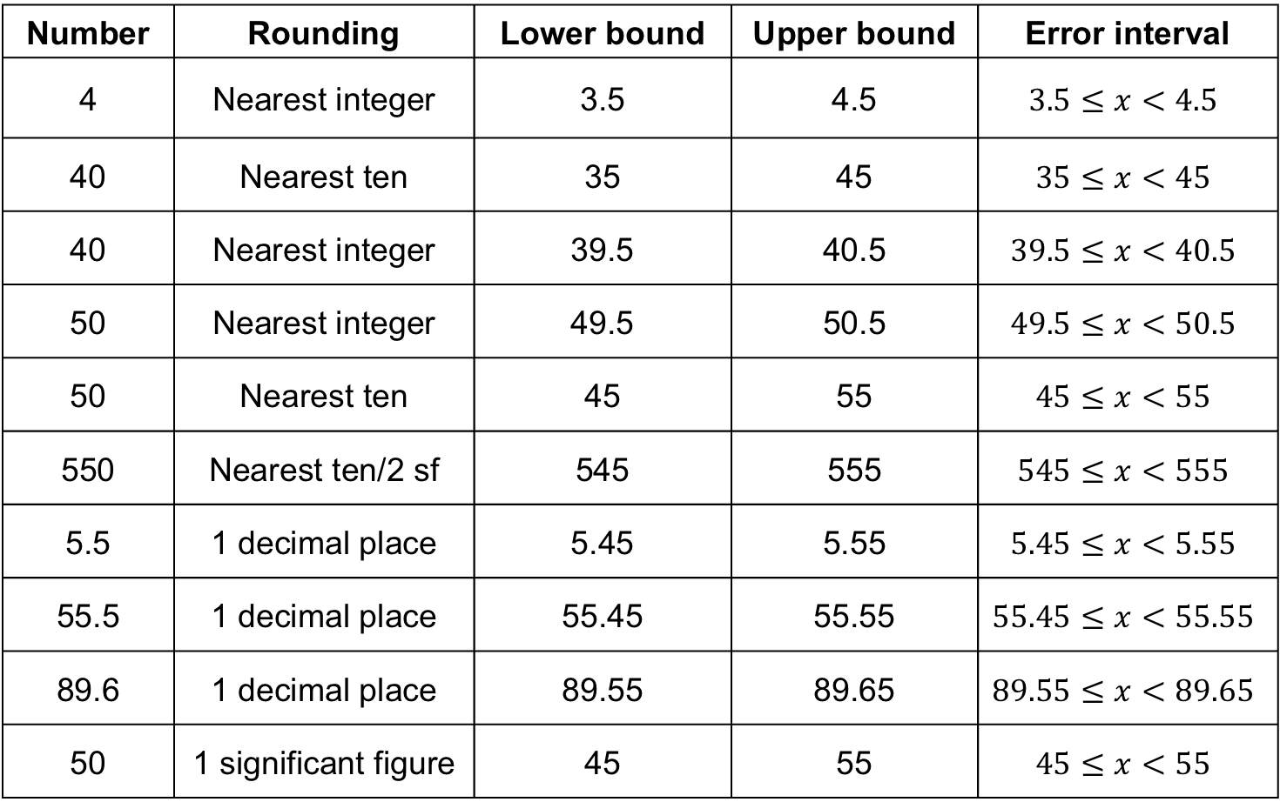
Upper and lower bounds
Fill in the blanks from the table. Click the blanks to reveal them.
Number | Rounding | Lower bound | Upper bound | Error interval
4 | Nearest integer | 3.5 | 4.5 | $$3.5≤x<4.5$$
40 | Nearest ten | 35 | 45 | $$35≤x<45$$
40 | Nearest integer | 39.5 | 40.5 | $$39.5≤x<40.5$$
50 | Nearest integer | 49.5 | 50.5 | $$49.5≤x<50.5$$
50 | Nearest ten | 45 | 55 | $$45≤x<55$$
550 | Nearest ten/2 sf | 545 | 555 | $$545≤x<555$$
5.5 | 1 decimal place | 5.45 | 5.55 | $$5.45≤x<5.55$$
55.5 | 1 decimal place | 55.45 | 55.55 | $$55.45≤x<55.55$$
89.6 | 1 decimal place | 89.55 | 89.65 | $$89.55≤x<89.65$$
50 | 1 significant figure | 45 | 55 | $$45≤x<55$$

Slide 7
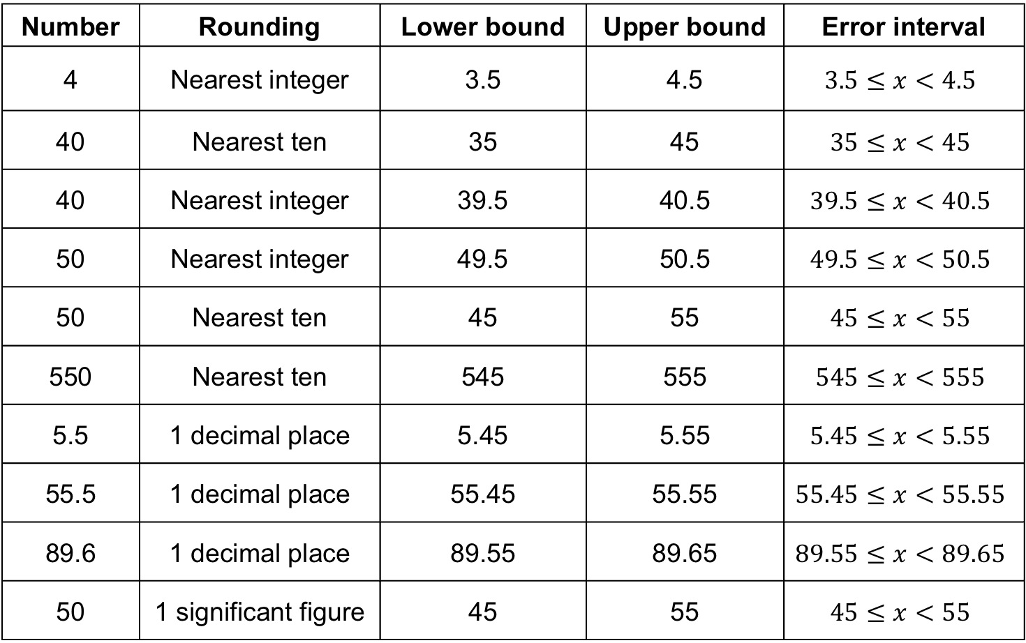
Upper and lower bounds
Fill in the blanks from the table
Number | Rounding | Lower bound | Upper bound | Error interval
4 | Nearest integer | 3.5 | 4.5 | $$3.5≤x<4.5$$
40 | Nearest ten | 35 | 45 | $$35≤x<45$$
40 | Nearest integer | 39.5 | 40.5 | $$39.5≤x<40.5$$
50 | Nearest integer | 49.5 | 50.5 | $$49.5≤x<50.5$$
50 | Nearest ten | 45 | 55 | $$45≤x<55$$
550 | Nearest ten | 545 | 555 | $$545≤x<555$$
5.5 | 1 decimal place | 5.45 | 5.55 | $$5.45≤x<5.55$$
55.5 | 1 decimal place | 55.45 | 55.55 | $$55.45≤x<55.55$$
89.6 | 1 decimal place | 89.55 | 89.65 | $$89.55≤x<89.65$$
50 | 1 significant figure | 45 | 55 | $$45≤x<55$$

Slide 8

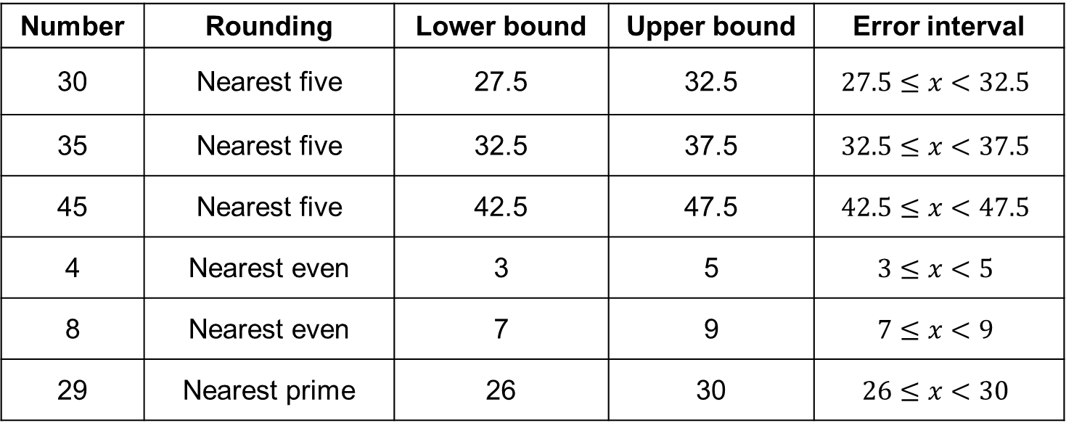
Upper and lower bounds
Look at the following number line. What error interval does it represent?
Look at the following table of numbers rounded unconventionally. Fill in the gaps and draw a number line for each error interval.
Number | Rounding | Lower bound | Upper bound | Error interval
30 | Nearest five | 27.5 | 32.5 | $$27.5≤x<32.5$$
35 | Nearest five | 32.5 | 37.5 | $$32.5≤x<37.5$$
45 | Nearest five | 42.5 | 47.5 | $$42.5≤x<47.5$$
4 | Nearest even | 3 | 5 | $$3≤x<5$$
8 | Nearest even | 7 | 9 | $$7≤x<9$$
29 | Nearest prime | 26 | 30 | $$26≤x<30$$

Slide 9
Upper and lower bounds
THINK
Mark is 36 years old. His age is represented by $x$. Give the error interval for $x$.
Adam is 42 years old. His age is represented by $x$. Give the error interval for $x$.
Notes:
This is an example problem pair. The best place to start out with these is Craig Barton’s book ‘How I Wish I Taught Maths’. The basic idea is this : they copy down the slide. You do the example, writing on the powerpoint and they copy it down. You then reveal the ‘your turn’ question. They then have a go and you can check they can apply the procedure correctly. It’s a really nice way of teaching, I’ve found. I have left the explanation completely up to you, as I wanted to get away from clicking through explanations, which I’m not a fan of.

Slide 10









Upper and lower bounds
I’ve broken some calculators.
For each screen: what’s the biggest the number could have been? What’s the smallest? Write you answer as error interval.
1
2
3
$$450≤x<459$$
$$5900≤x<5999$$
$$100≤x<199$$
4
5
159000 has been truncated to 3 significant figures. Write down the error interval of the number.
$$159000≤x<159999$$
$$159000≤x<159999$$
Notes:
This idea is stolen from Mr Mattock https://www.tes.com/teaching-resource/errors-in-truncation-11271966 buy his book https://www.bookdepository.com/Visible-Maths-Peter-Mattock/9781785833502?ref=grid-view&qid=1620641664757&sr=1-1

Slide 11
Upper and lower bounds
Example | Your Turn
The number of people on a bus is given as 50, correct to the nearest 10. What is the lowest and highest possible number of people on the bus? | There are 9500 Red pandas left in the wild. This number is accurate to the nearest 500. What are the smallest and largest number of Sumatran orangutans that can be left?
Notes:
Let’s think about discrete bounds

Slide 12
Upper and lower bounds
Here are some species of animal, and their numbers left in the wild (according to the WWF). Find their upper and lower bounds.
Animal | Number left | Rounding | Lower Bound | Upper Bound
African elephant | 415,000 | Nearest 1000 | 414,500 | 415,499
Amur leopard | 60 | Nearest 10 | 55 | 64
Black rhino | 5,500 | Nearest 100 | 5,450 | 5,549
Galápagos penguin | 2,000 | Nearest 1000 | 1500 | 2449
Greater sage-grouse | 100,000 | Nearest 100,000 | 50,000 | 149,999
Vaquita dolphin | 10 | Nearest 5 | 8 | 12
Sundra tiger | “Under 400” | ?!? | 399 | 0
Notes:
Let’s think about discrete bounds

Slide 13
Upper and lower bounds
An exam style question…
Two performances of a show are each attended by 175 people, to the nearest 5. Work out the maximum possible difference between the numbers of people attending.
Notes:
Let’s think about discrete bounds

